Slide 1
Selecting neighborhood to live in

Slide 2
Rationale
Each time a person moves they must decide which neighborhood to live in.
Each person places value on different items when selecting a place to live.
The capability to evaluate the neighborhoods in a new area offers a benefit each time a person moves, especially when the person may be unfamiliar with the area.

Slide 3
Data
Open Data DC
Unique neighborhoods and latitude/longitude of each.
Foursquare
Venues within proximity to each unique neighborhood.

Slide 4
Types of venues and categories of interest
317 unique categories
Coffee shops
Coffee shops, Bakery, Cupcake shop, Dessert shop, Pie shop, Café, Bagel shop
Activities
Indie movie theater, Music venue, Performing arts venue, Theater
Gyms
Gym, Cycle studio, Outdoor gym, Roller rink, Gym/fitness center

Slide 5
Types of venues and categories of interest, cont’d
Restaurants
African Restaurant, Arepa Restaurant, Asian Restaurant, Belgian Restaurant, Brazilian Restaurant, Cajun / Creole Restaurant, Cantonese Restaurant, Caribbean Restaurant, Chinese Restaurant, Comfort Food Restaurant, Cuban Restaurant, Dumpling Restaurant, Eastern European Restaurant, Ethiopian Restaurant, Falafel Restaurant, Filipino Restaurant, Fish & Chips Shop, French Restaurant, Fried Chicken Joint, German Restaurant, Greek Restaurant, Italian Restaurant, Japanese Restaurant, Korean Restaurant, Latin American Restaurant, Mediterranean Restaurant, Mexican Restaurant, Middle Eastern Restaurant, Pakistani Restaurant, Persian Restaurant, Peruvian Restaurant, Portuguese Restaurant, Ramen Restaurant, Scandinavian Restaurant’, 'Seafood Restaurant, South American Restaurant, Spanish Restaurant, Steakhouse, Sushi Restaurant, Taco Place, Tapas Restaurant, Thai Restaurant, Turkish Restaurant, Vietnamese Restaurant'

Slide 6
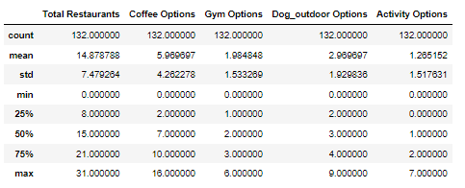
Categories of interest statistics
Determine number of venues within each neighborhood for each category of interest.
Examine statistics of the number of distinct venues.
Set minimum required number of options within each category of interest.

Slide 7
Requirements for neighborhood
Neighborhood must have at least 6 unique restaurants,
at least 3 gym and coffee/bakery options,
at least 2 potential activities that could be done with the dog, and
at least 1 entertainment activity.

Slide 8
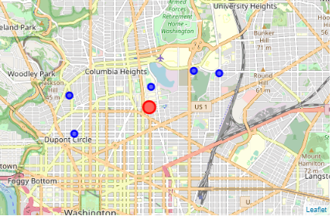
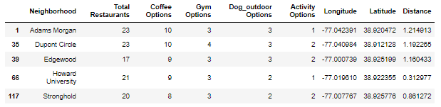
Examine proximity of neighborhoods
Red dot highlights the graduate’s new job.
The blue dots surrounding represent the neighborhoods that meet the minimum requirements and is within a mile and a half of the new job.

Slide 9
Examine unique cuisines in neighborhoods
Each neighborhood offers similar number of total restaurants, though Edgewood has fewer than others.
Therefore, important to also evaluate the number of unique cuisines within each number, as that may serve as distinguisher.
17 unique cuisines in Adams Morgan
15 in Dupont Circle
14 in Edgewood
16 in Howard University, and
14 in Stronghold

Slide 10
Recommendations
Based on proximity and number of options within each category recommend that the graduate look to live in Howard University neighborhood first.
If Howard University is not possible, look to live in Stronghold.

